Slide 1

Impact of Disasters on Human Life
Group 7:
Shreya Karakata
Monalisa Emandi
Mohith Kota

Slide 2
Set of Questions
What is most dangerous disaster, when and where did it occur?
Which is the most affected region?
Which country and continent has the highest deaths?
Which part of the year should the people be more precautious?
How did the deaths vary throughout the years?
Is there any relation between the frequency of the disasters and the deaths caused by them
Which disaster lasted long and cause the most damage?

Slide 3
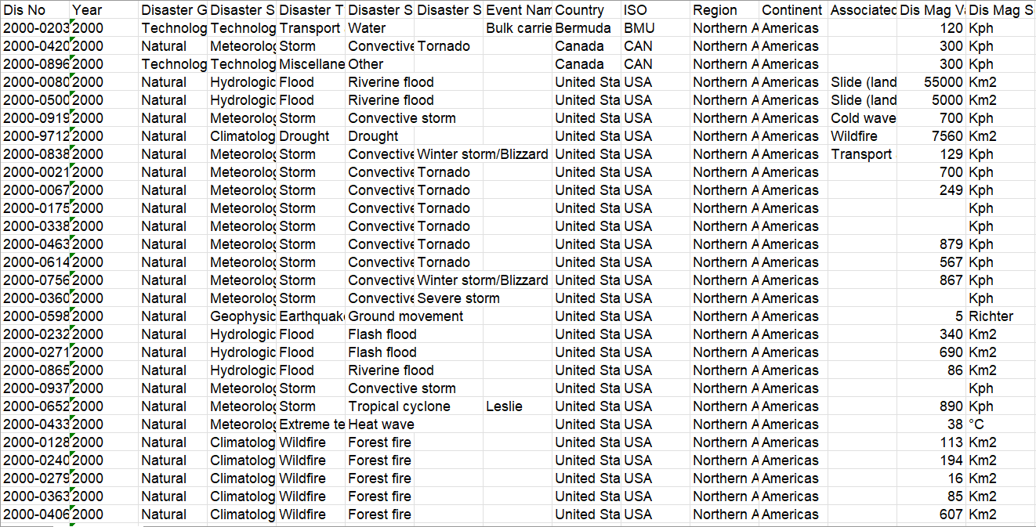
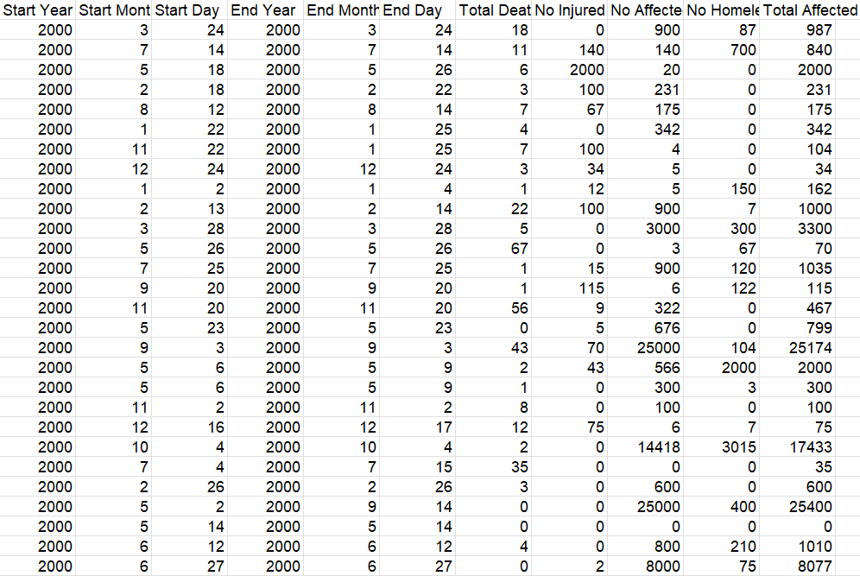
Snapshot of the Dataset

Slide 4
Exploratory Data Analysis
About the data
Source: EM-DAT
The data comprises of disasters that occurred from 2000-2022 across various countries/regions and the number of people affected by them.
It has around 5600 records with 35 columns where 20 columns are numerical and 15 columns are categorical.
Data cleaning
Removed missing data in few categories of disasters as they had significant amount of missing information and imputed few with median.
Identified outliers in Total Deaths, Total affected and other columns using box plots, scatter plots, and removed them.
After cleaning, we have a total of 5595 rows and 21 Columns, where are 11 numerical columns and 8 categorical columns, 2 Date columns.
Disaster Type, Total Deaths, Number Injured, Number Homeless, Country, Continent etc.

Slide 5
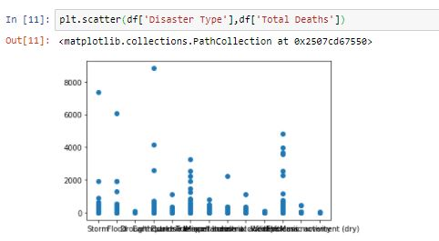
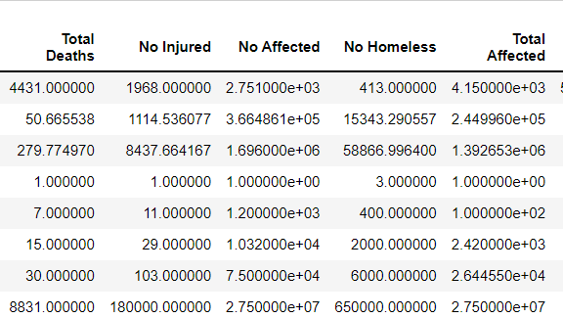
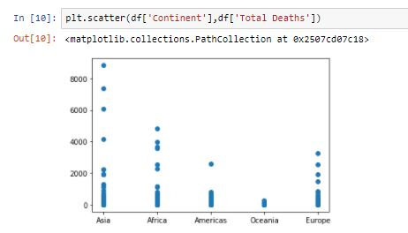

Exploratory Data Analysis
Summary Statistics
fv

Slide 6
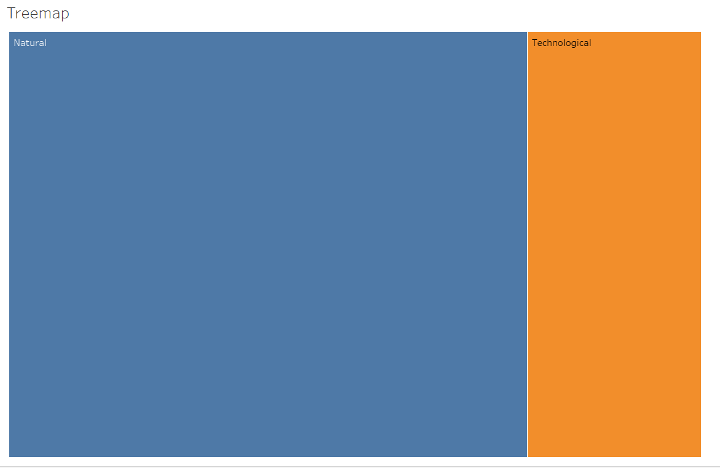
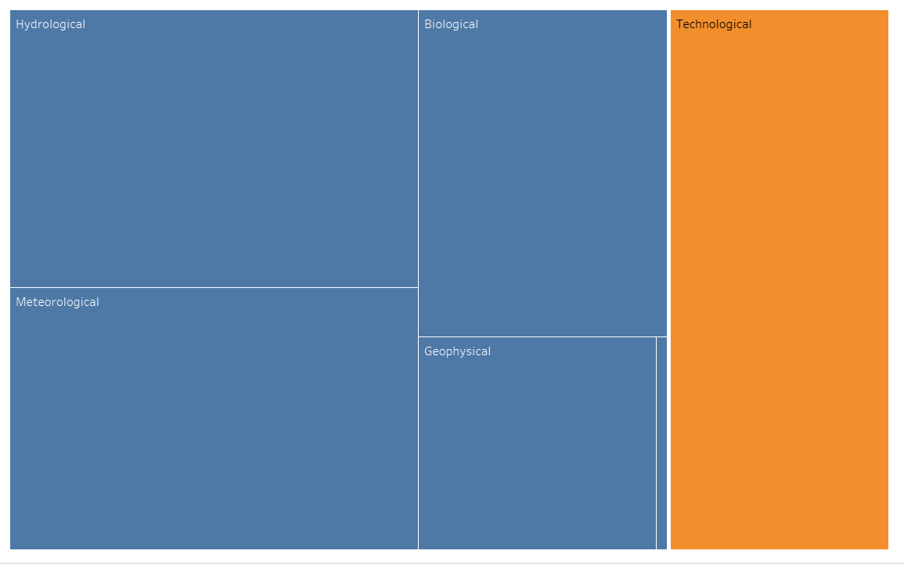
Visualizations
Treemap: Showing the hierarchy and categorization of the disasters based on frequency of Occurrence

Slide 7
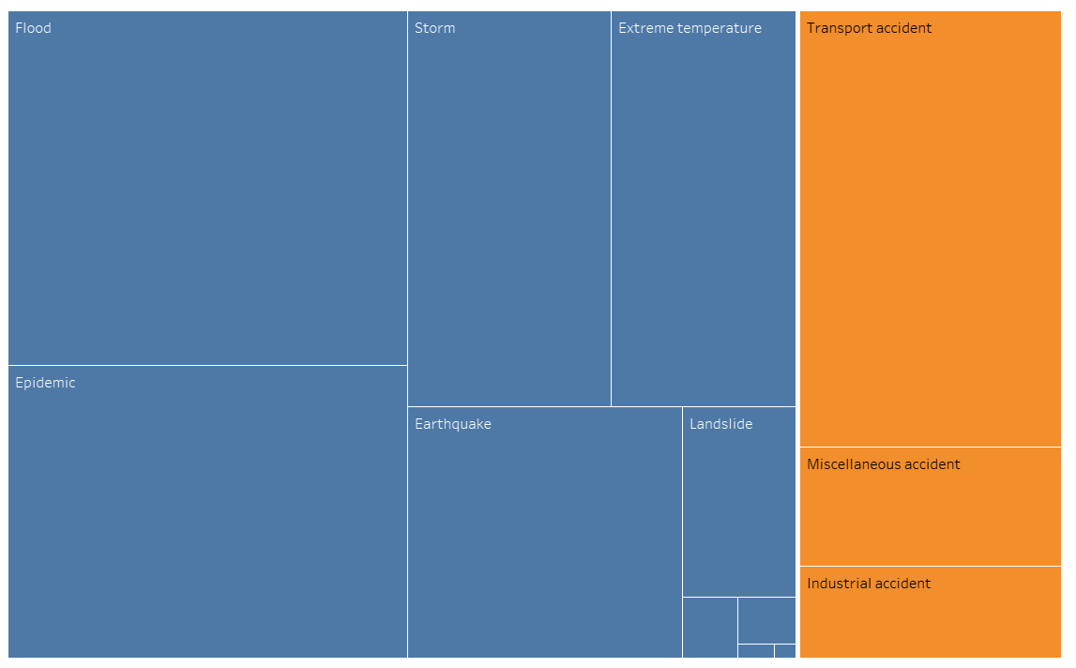
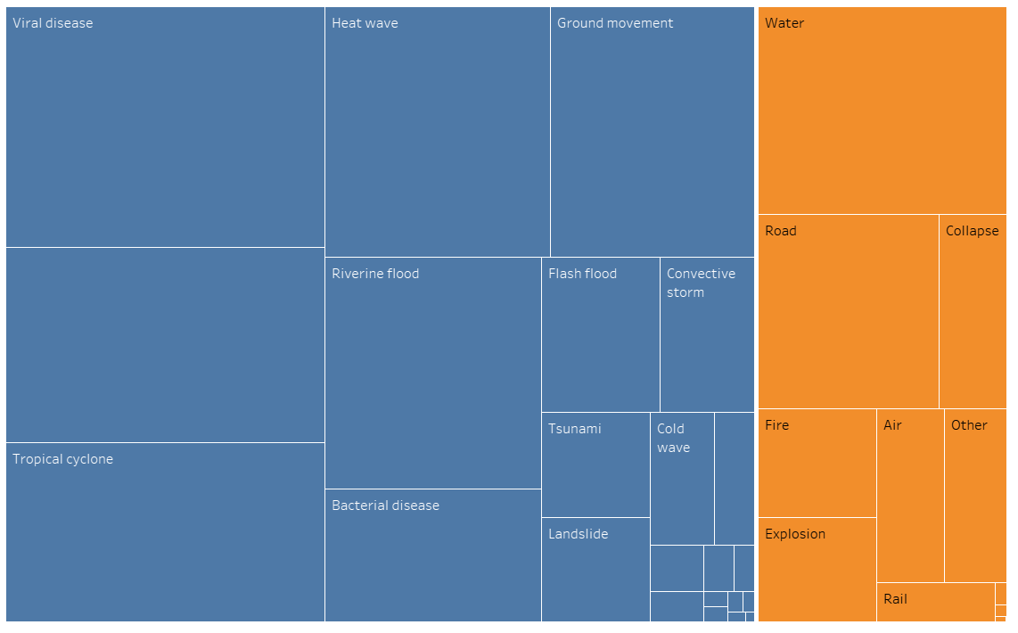
Visualizations

Slide 8
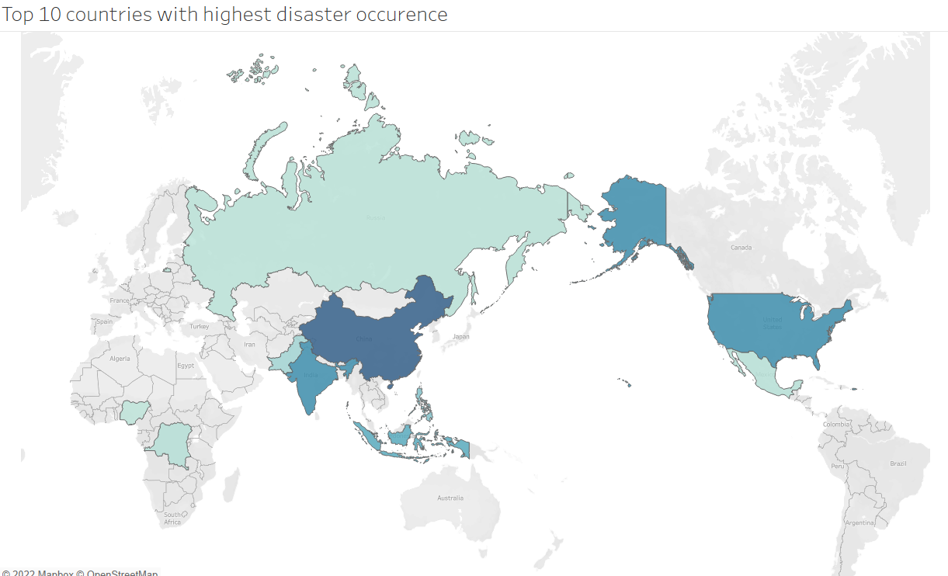
Visualizations
World map : Showing top 10 Countries which are disaster proned.

Slide 9
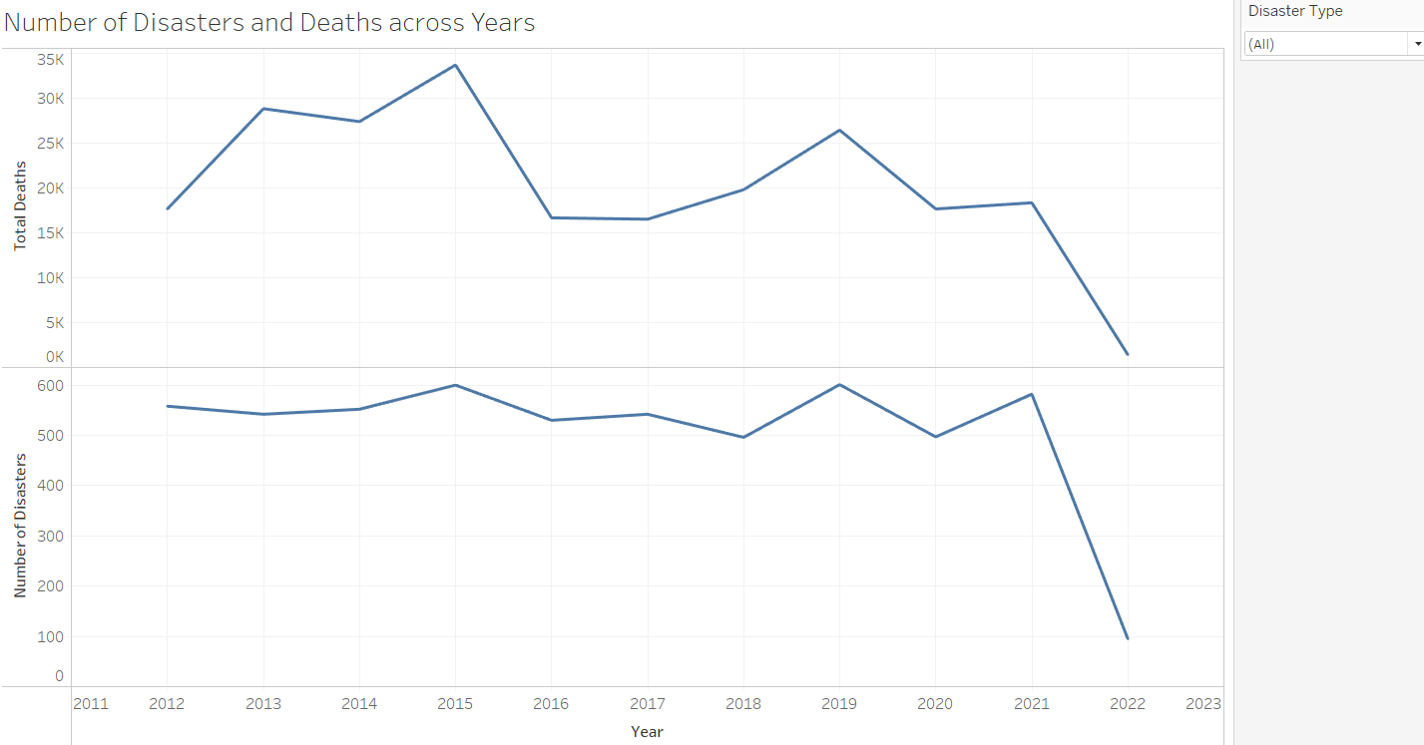
Visualizations
Time series: Showing the number of deaths and total disasters over the years

Slide 10
Key Message
Disasters had always been a cause for both economic as well as social loss. Therefore, policymakers of all the continents across the world should always maintain a stable economic as well as infrastructural contribution towards the prevention, action as well as recovery from the impact of any disaster that occurs.
Continuous analysis of the disasters and their impacts will aid the government in making meaningful predictions and planning for precaution measures for inevitable disasters.

Slide 11
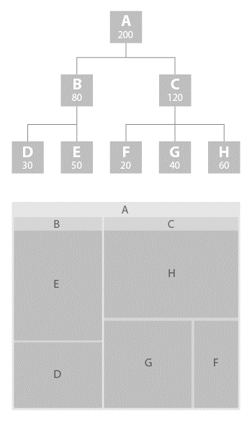
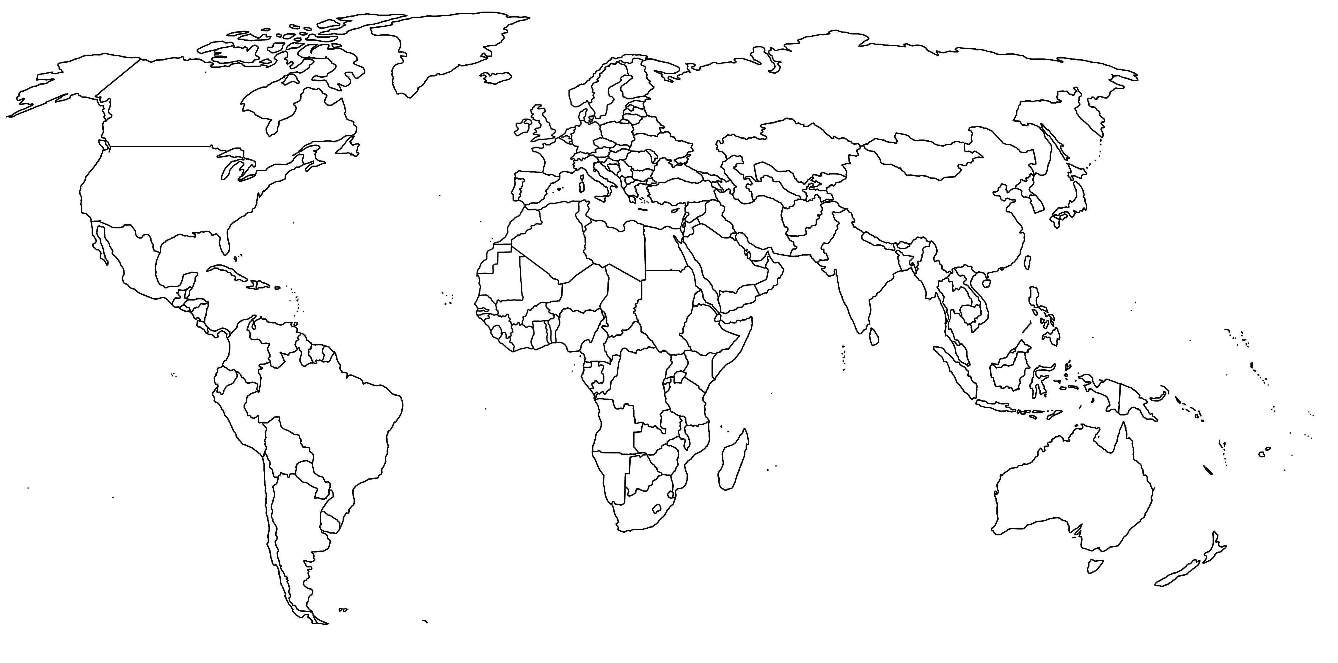


Pencil sketch of Dashboard
Tree Map: Interactive tree map to show hierarchy of disasters.
World Map: Highlight states with most affected disaster . User has option to chose disaster type
Time Series of number of deaths of disasters. User has option to chose for particular continent and disaster type.
Bar charts : Showing top disaster types along with continents most affected. User has option to select.

Slide 12
Thank You

